Slide 1
E3ME-FTT Summerschool
Day 3: Future Technology Transformations
06-06-2023
2023 edition

Slide 2

Contents
1. Introduction to FTT
2. Mathematical Framework
3. Feedbacks to/from E3ME
4. Policy options
5. Scenario design
6. FTT Stand-alone
7. Hands-on session

Slide 3

Introduction to FTT

Slide 4
What is FTT?
Short for Future Technology Transformation
Can be classified as a post-Schumpeter, evolutionary, innovation model
FTT seeks to mimic the behaviour of entrepreneurs from a macro perspective
Framework was designed by Jean-Francois Mercure for the power sector
Since then, models have been developed for the passenger road transport, freight road transport, residential heating, industrial heating, and iron and steel sectors
Soon to be expanded by an FTT model that deal with agricultural decision-making (and potentially land-use)
Also currently in the works is a representation of the hydrogen supply model
Colleagues at the World Bank are investigating the feasibility of developing Marine and Aviation transport models

Slide 5

How does FTT work?
FTT steps into the shoes of the entrepreneur
Estimates technology-specific cost of production
Accounts for uncertainty (varying local conditions, different expectations/valuation of the future, more risk-averse/seeking of agents, etc.) which is reflected in distributed preferences
Preferences are fed in to the decision-making core
Ultimately, FTT mimics the characteristic S-shaped curve
FTT feeds prices, investment, and final energy consumption back to E3ME where it communicates to other parts of the model

Slide 6
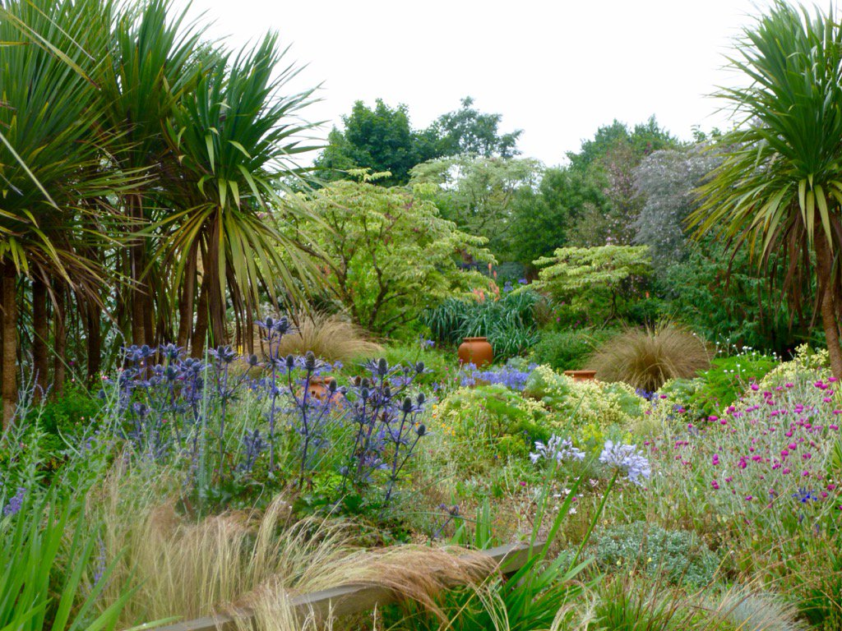
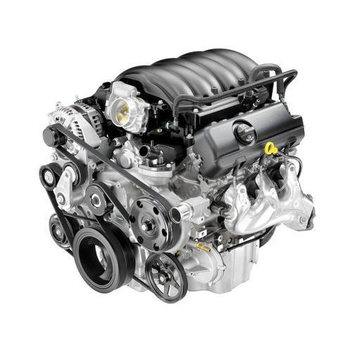
Why do we use FTT?
Econometric treatment does not take into account innovation or technical limits or the consequences properly!
Innovation as a phenomenon is opposite of routine
Econometric parameters are not policy invariant and may not be applicable when policies / ‘the rules of the game’ change (Lucas critique)
However, the assumptions of how a sector works or is constrained may not be policy invariant though!
Allows inclusion of detailed policies beyond price signalling
We are interested in finding out how technologies develop and how they potentially can be promoted
Promoting specific technologies requires different way of thinking: A well-oiled machine versus tending to a wild garden

Slide 7
Mathematical Framework

Slide 8
Theoretical framework
Uncertainty is key in FTT and there are many sources of uncertainty. The heterogeneity of agents is just one of them
Technologies compete with each other for market shares on the basis of expected costs differentials, which can be influenced by
FTT uses a replicator function to determine market share changes based on the Lotka-Volterra (LV) equation (or predator-prey)
Entrepreneurs seek finance/loans for their entrepreneurial endeavours; they are risk-seeking; they have different expectations/valuations of the future
The LV equation contains parameters for “births” and deaths”, like in demographic and ecological modelling
For a full description of the theoretical and mathematical framework I refer to:
Mercure, J. F. (2012). “FTT: Power: A global model of the power sector with induced technological change and natural resource depletion”. Energy Policy, 48, 799-811.
Mercure, J. F. (2015). “An age structured demographic theory of technological change”. Journal of Evolutionary Economics, 25(4), 787-820.

Slide 9
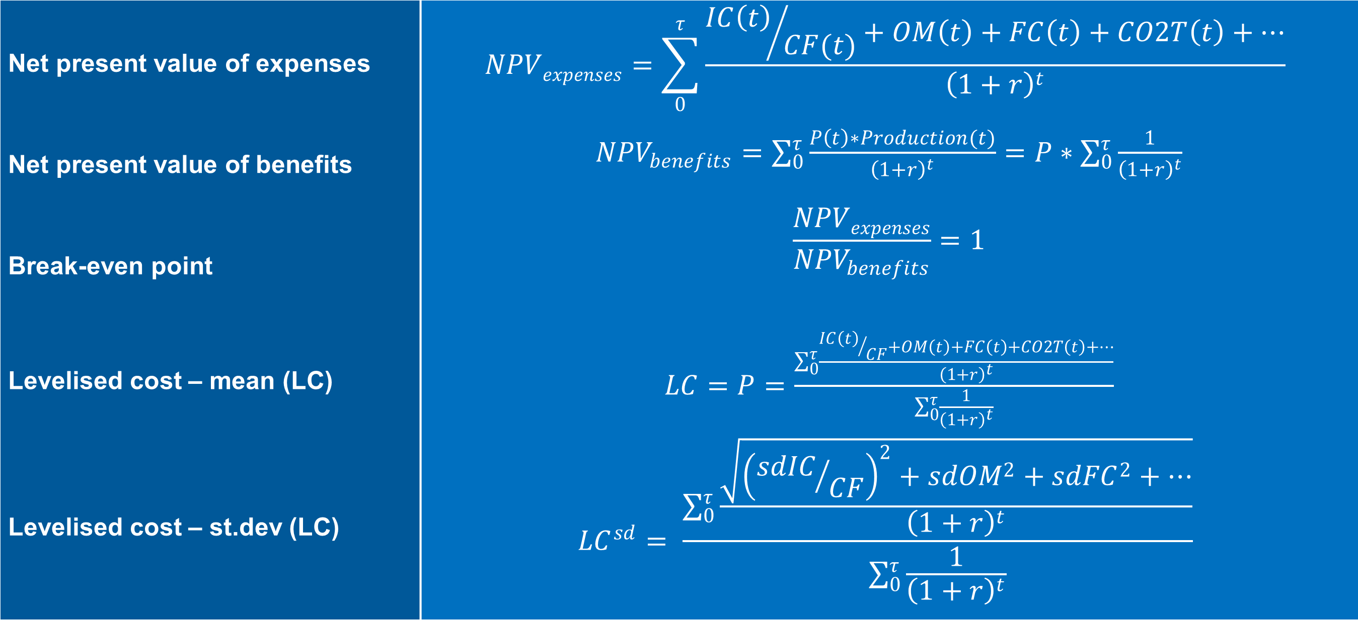
Levelised cost
Net present value of expenses | $$NPVexpenses=\sum_{0}^{τ}{\frac{{IC\left(t\right)}/{CF(t)}+OM\left(t\right)+FC\left(t\right)+CO2T\left(t\right)+…}{{\left(1+r\right)}^{t}}}$$
Net present value of benefits | ${NPV}_{benefits}=$ $\sum_{0}^{τ}{\frac{P\left(t\right)∗Production(t)}{{\left(1+r\right)}^{t}}}=P∗\sum_{0}^{τ}{\frac{1}{{\left(1+r\right)}^{t}}}$
Break-even point | $$\frac{NPVexpenses}{{NPV}_{benefits}}=1$$
Levelised cost – mean (LC) | $LC=P=$ $\frac{\sum_{0}^{τ}{\frac{{IC\left(t\right)}/{CF}+OM\left(t\right)+FC\left(t\right)+CO2T\left(t\right)+…}{{\left(1+r\right)}^{t}}}}{\sum_{0}^{τ}{\frac{1}{{\left(1+r\right)}^{t}}}}$
Levelised cost – st.dev (LC) | $${LC}^{sd}= \frac{\sum_{0}^{τ}{\frac{\sqrt{{\left({sdIC}/{CF}\right)}^{2}+{sdOM}^{2}+{sdFC}^{2}+…}}{{\left(1+r\right)}^{t}}}}{\sum_{0}^{τ}{\frac{1}{{\left(1+r\right)}^{t}}}}$$

Slide 10
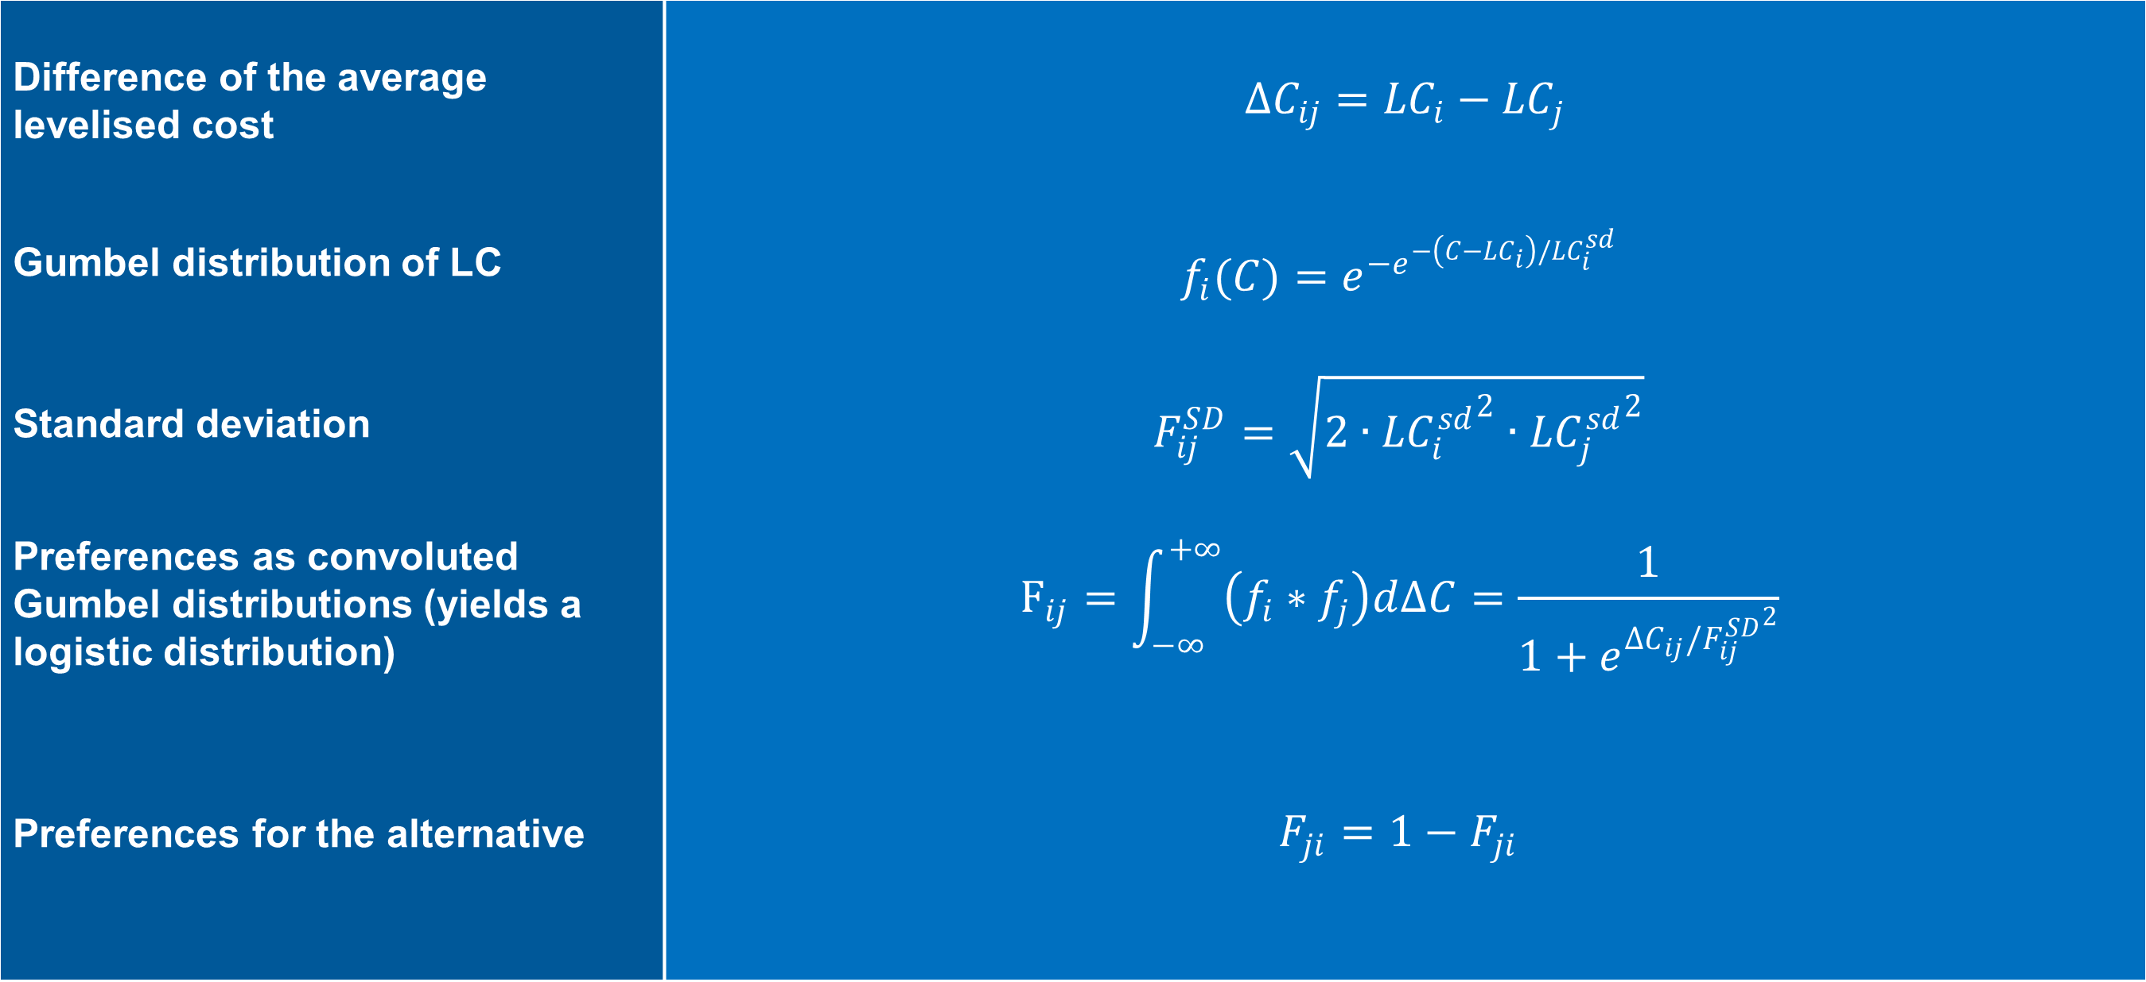
Investor preferences
Difference of the average levelised cost | $∆C_{ij}={LC}_{i}−{LC}_{j}$
Gumbel distribution of LC | $$f_{i}(C)=e^{{−e}^{−\left(C−{LC}_{i}\right)/{LC}_{i}^{sd}}}$$
Standard deviation | $$F_{ij}^{SD}=\sqrt{2∙{{LC}_{i}^{sd}}^{2}∙{{LC}_{j}^{sd}}^{2}}$$
Preferences as convoluted Gumbel distributions (yields a logistic distribution) | $$F_{ij}=\int_{−∞}^{+∞}{\left(f_{i}∗f_{j}\right)d∆C}=\frac{1}{1+e^{{∆C}_{ij}/{F_{ij}^{SD}}^{2}}}$$
Preferences for the alternative | $$F_{ji}={1−F}_{ji}$$

Slide 11
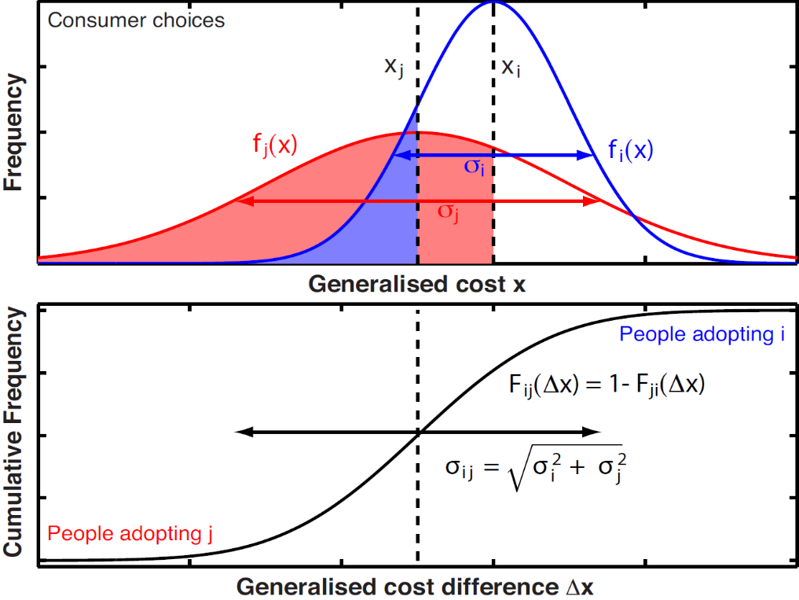
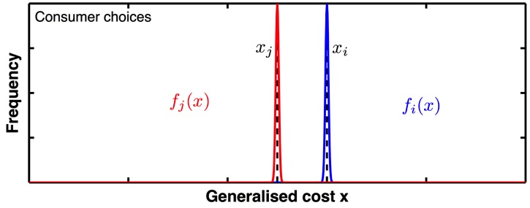
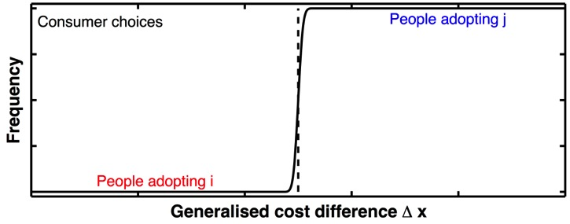
Imperfect preferences
Imperfect information / knowledge / foresight
Perfect information / knowledge / foresight

Slide 12
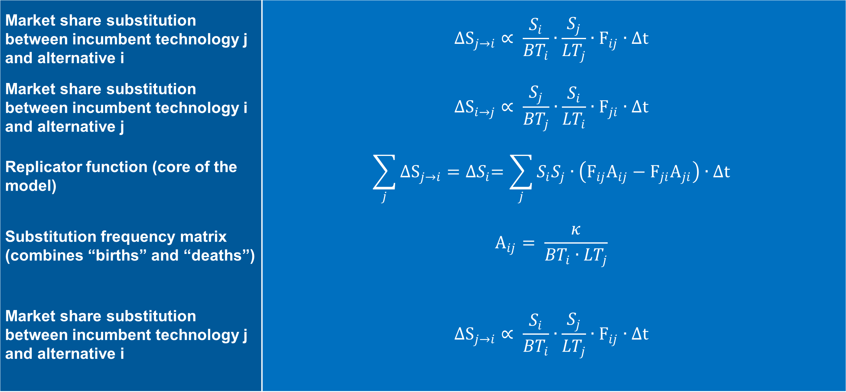
Market share dynamics
Market share substitution between incumbent technology j and alternative i | $$∆S_{j→i}∝ \frac{S_{i}}{{BT}_{i}}∙\frac{S_{j}}{{LT}_{j}}∙F_{ij}∙∆t$$
Market share substitution between incumbent technology i and alternative j | $$∆S_{i→j}∝ \frac{S_{j}}{{BT}_{j}}∙\frac{S_{i}}{{LT}_{i}}∙F_{ji}∙∆t$$
Replicator function (core of the model) | $$\sum_{j}{∆S_{j→i}}={∆S}_{i}=\sum_{j}{S_{i}S_{j}∙\left(F_{ij}A_{ij}−F_{ji}A_{ji}\right)∙∆t}$$
Substitution frequency matrix (combines “births” and “deaths”) | $$A_{ij}= \frac{κ}{{BT}_{i}∙{LT}_{j}}$$
Market share substitution between incumbent technology j and alternative i | $$∆S_{j→i}∝ \frac{S_{i}}{{BT}_{i}}∙\frac{S_{j}}{{LT}_{j}}∙F_{ij}∙∆t$$

Slide 13
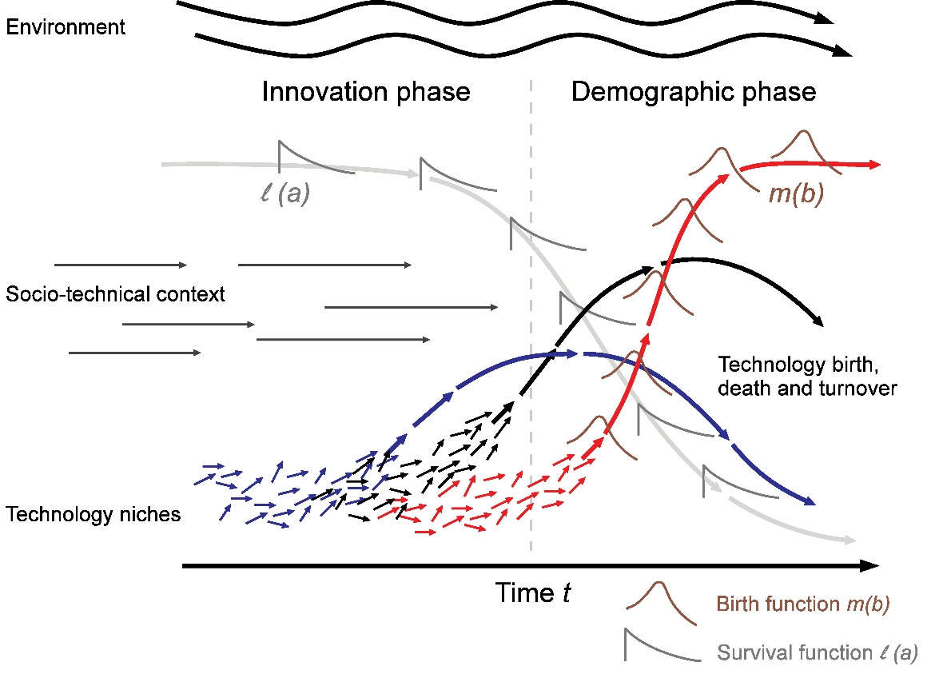
Market share dynamics
Technology diffusion takes place in a certain context
Technology diffusion may change the context
Not all efforts are successful
Source: Mercure (2015), DOI: 10.1007/s00191-015-0413-9 (adapted from Geels (2002), DOI: 10.1016/S0048-7333(02)00062-8)

Slide 14
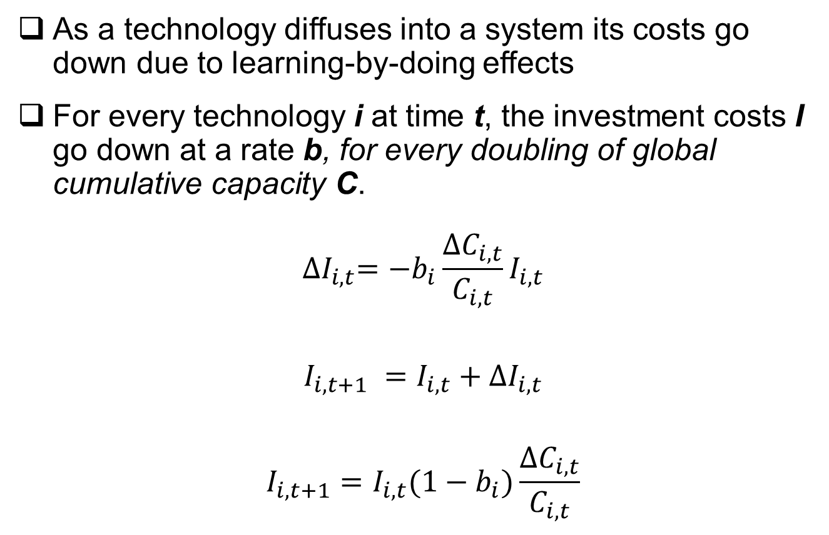
Wright’s Law
As a technology diffuses into a system its costs go down due to learning-by-doing effects
For every technology i at time t, the investment costs I go down at a rate b, for every doubling of global cumulative capacity C.
$${∆I}_{i,t}={−b}_{i}\frac{{∆C}_{i,t}}{C_{i,t}}I_{i,t}$$
$$I_{i,t+1} =I_{i,t}+{∆I}_{i,t}$$
$$I_{i,t+1}={I_{i,t}(1−b}_{i})\frac{{∆C}_{i,t}}{C_{i,t}}$$

Slide 15
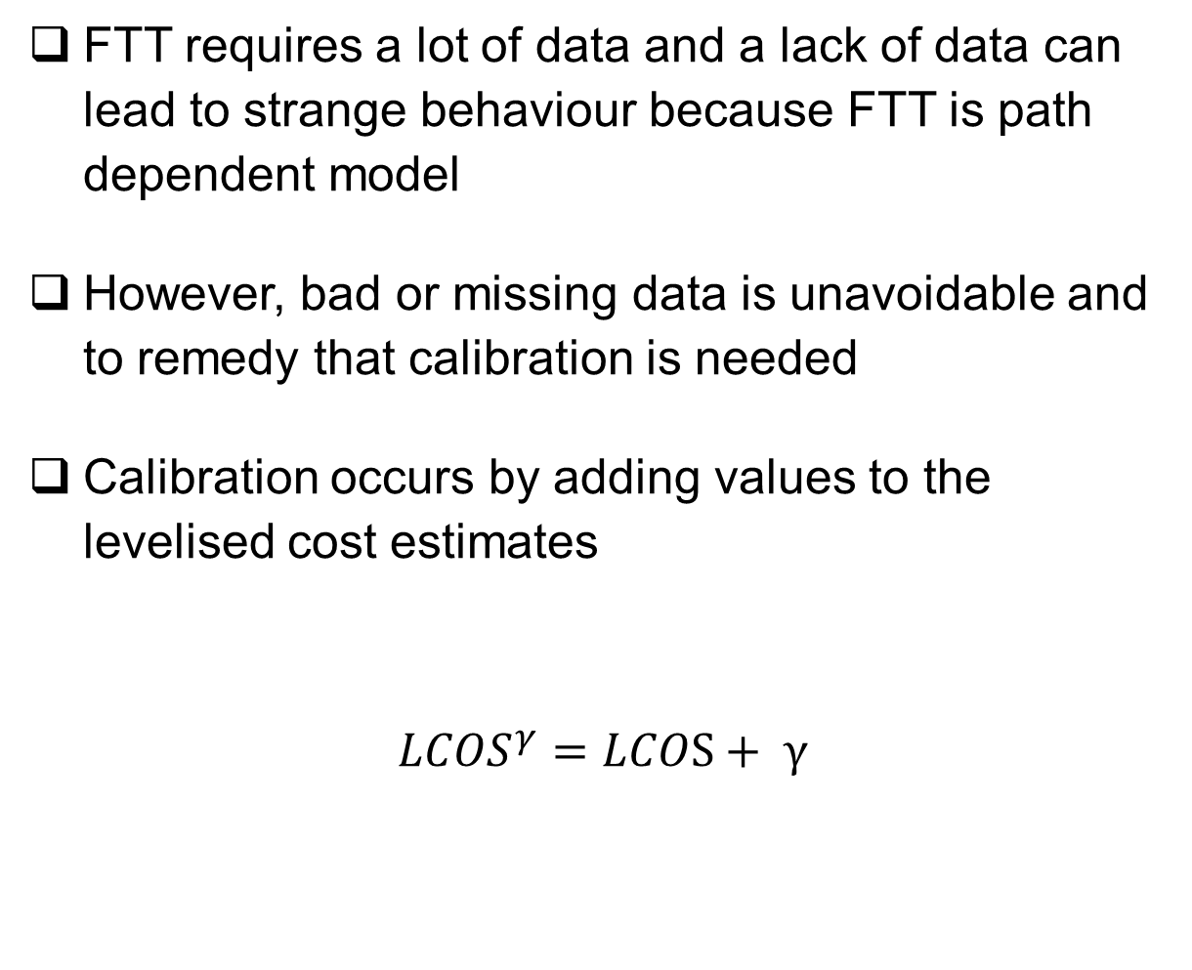
Calibrating FTT
FTT requires a lot of data and a lack of data can lead to strange behaviour because FTT is path dependent model
However, bad or missing data is unavoidable and to remedy that calibration is needed
Calibration occurs by adding values to the levelised cost estimates
$${LCOS}^{γ}=LCOS+ γ$$
The calibrated levelised cost feed into the preference matrix which changes the decision-making core
We calibrate “by eye” and calibration is assumed to be finished when the market share increments of the last few historical years are aligned to the market share increments of the first few simulated years
The gamma value can represent various things that the FTT model is missing, e.g. non-pecuniary costs, technology price premium, historical policy effects, etc.

Slide 16
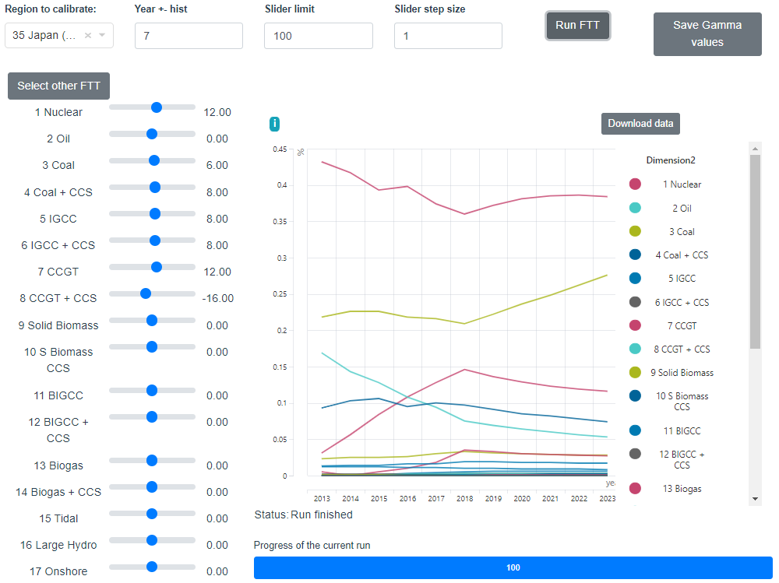
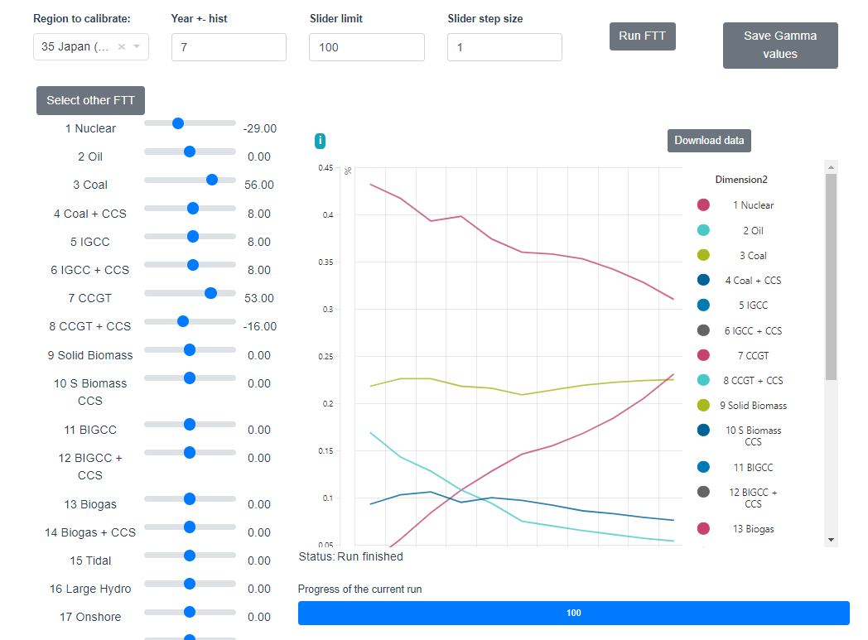
Calibrating FTT

Slide 17
Feedbacks to/from E3ME

Slide 18
Feedbacks
E3ME provides…:
The land-scape
Demand estimation (e.g. electricity demand) through the detailed national accounting framework
Responses to FTT inputs
FTT provides…:
Price levels
Investment needs
Employment (in some cases)
Energy demand
Responses to a changing land-scape

Slide 19
Connecting E3ME and FTT
Cost-supply curves Feeds back fossil fuel prices and renewable resource limitations
Policy Assumptions
Economic feedbacks
GHG Emissions
Energy demand / primary energy price
Policy assumptions Carbon tax
Technology support
Energy tax/rebates Etc.
Energy demand / transformed energy price
Land productivity
FTT (in use)
Consumer
Commercial / Industry
Industry / Energy transformation
FTT (prospective)
FTT:RH
FTT:PRT
FTT:FRT
FTT:S
FTT:IH
FTT:P
FTT:H2
FTT:Agri
Land-use
Climate impacts
Policies
Cost-supply curve
Electricity / Hydrogen / Biofuel prices
E3ME
GHG emissions
Global warming
Emissions
E3ME Economy module
Climate feedback (prospective)

Slide 20


15 minute break

Slide 21
Policy options

Slide 22
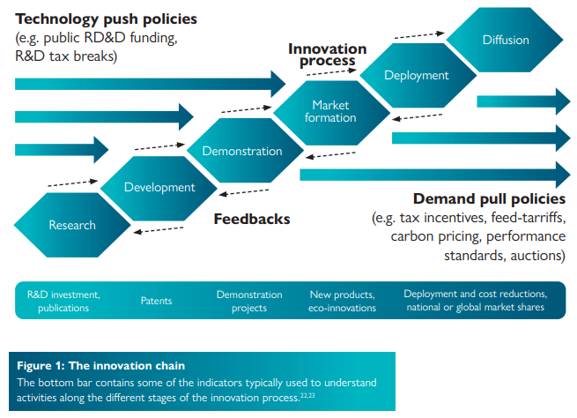
FTT allows for a range of policies
Policies can influence the innovation process in various ways
IAMs predominantly consider a carbon tax or carbon price as the ultimate climate mitigation policy, i.e. “the market will take care of it”
However, carbon pricing is not the only option available to policymakers
In the past support policies have been successful in helping specific technologies diffuse into the markets (e.g. LED in India, Solar PV in Japan / Germany)
A technology diffusion model that seeks to be relevant to policymakers must account for a range of policies with different mechanisms
Source: Grubb, M., et al. (2021). The New Economics of Innovation and Transition: Evaluating Opportunities and Risks.

Slide 23
FTT allows for a range of policies
Carbon tax
Energy/Material tax/rebate
Subsidies on upfront investment
Feed-in-Tariffs
Will change the LC of technologies based on their emission intensity.
Interferes with preferences through LC!
Will change the LC of technologies based on their energy/material use intensity. Interferes with preferences through LC!
Will change the LC of technologies based on the upfront investment component. Interferes with preferences through LC!
Will change the LC of technologies directly to mimic the effect of an FiT. Interferes with preferences through LC!
Technology mandates
Kick-start
Market caps
Full phase-out regulations
Government set e.g. sales mandates that force a certain technology into the technology configuration. Alters market shares exogenously.
This represents governments investing directly in technologies, or to reflect the innovator effect to ensure there is some seeding. Alters market shares exogenously.
If a technology is capped at a certain capacity level, then endogenous uptake is prevented. Alters preferences directly.
If a technology is set to fully phase-out, then the endogenous market changes are prevented. Alters preferences directly.

Slide 24
Scenario design

Slide 25
How does one design a scenario?
Check history; path-dependency requires an accurate starting point
Policy effectiveness versus policy targets
FTT is not well suited to address policy targets given that it is strictly a simulation tool
However, we still often use E3ME-FTT to meet a certain target (most notably announced Net-Zero targets)
Strictly speaking, FTT can only inform the user on the effectiveness of policies towards a target
Consider the policy landscape of the region of interest
Are the policy options properly represented?
What are some of the important feedbacks that need to be captured?

Slide 26
FTT Stand-alone

Slide 27



FTT community
The University of Exeter, the World Bank, and Cambridge Econometrics have recently started to work together to create an FTT community
Within this community, we share data, code, and FTT models
These FTT models are stand-alone versions (i.e. not connected to E3ME or any other model), but they can be linked to other models
The code can be found on Github: https://github.com/cpmodel/FTT_StandAlone
The code is written in Python. All packages required to run the FTT models are listed and can be downloaded via a command batch file.
Very useful for learning FTT; Not useful for informing policymakers due to lack of important feedbacks with the rest of the economy

Slide 28
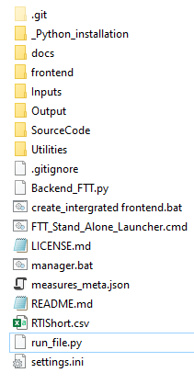
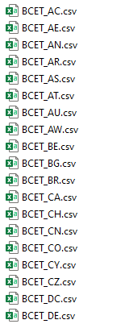
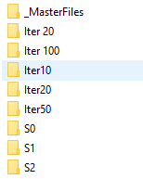
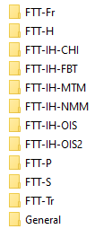
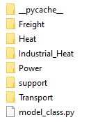
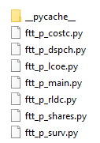
Folder structure
Python libraries installation
User manual and code documentation
Front-end files
Input files (all in .csv format)
Output files (stored in .pickle format)
Contains the model class, functions, and scripts
Contains model variables and dimensions
Script to generate the front-end
Launches the front-end by calling the back-end
…
Script to run the model class separately. Mainly required for debugging
Provides information to the model run

Slide 29
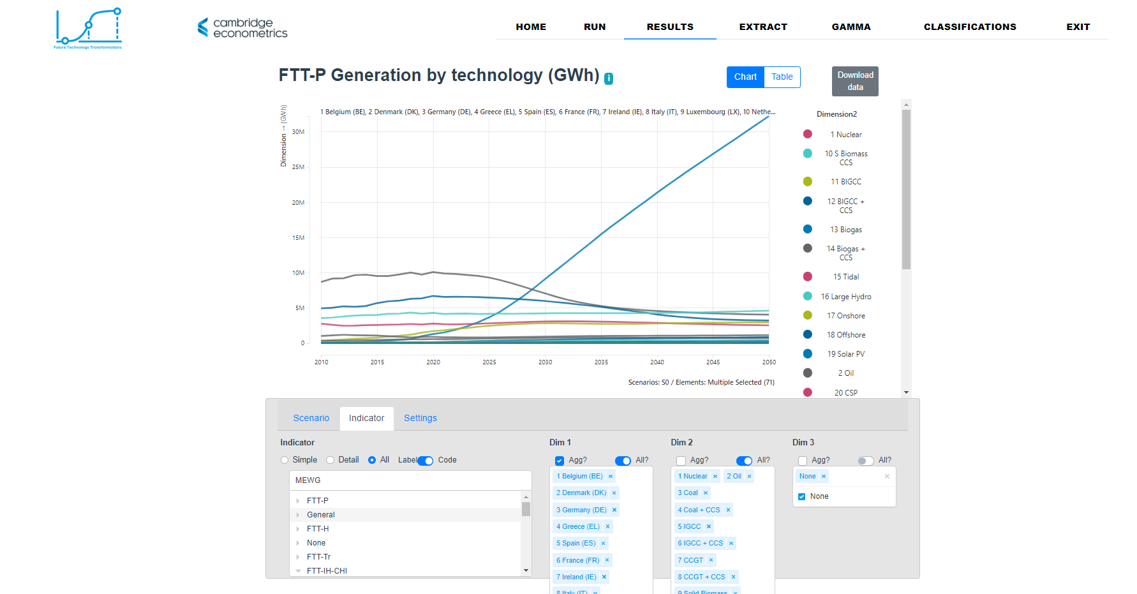
Using the front-end

Slide 30
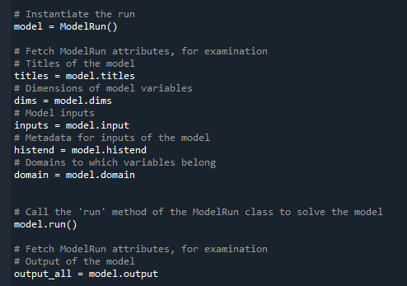
Using the run script
Alternatively, the user can run the stand-alone models using a simple script
See “run_file.py”
The user can interrogate the inputs and outputs separately
The user can interrogate all variables
The user can use this to debug the stand-alone versions of FTT

Slide 31
Hands-on session

Slide 32
Cambridge Econometrics
Covent Garden
Cambridge CB1 2HT
United Kingdom

